Slide 1
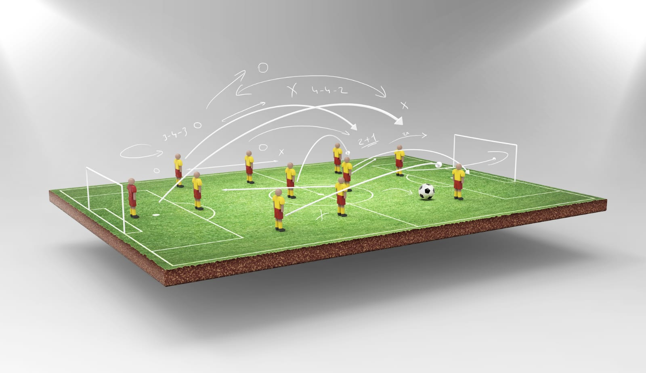

Hi Everyone, Here is My
TASK – 3 on
VERVE BRIDGE
TOPIC- FOOTBALL STRATEGY
- KHUSHI

Slide 2
The objective of this task is to create an interactive Power BI dashboard to visualize football strategies using the VerveBridge dataset. The project involves data cleaning, analysis, and presenting key insights on strategy types, trusted judgments, antecedent confidence, and unit states. The goal is to develop a clear and intuitive interface that enables users to explore and evaluate football strategies effectively, providing actionable insights for data-driven decision-making

Slide 3
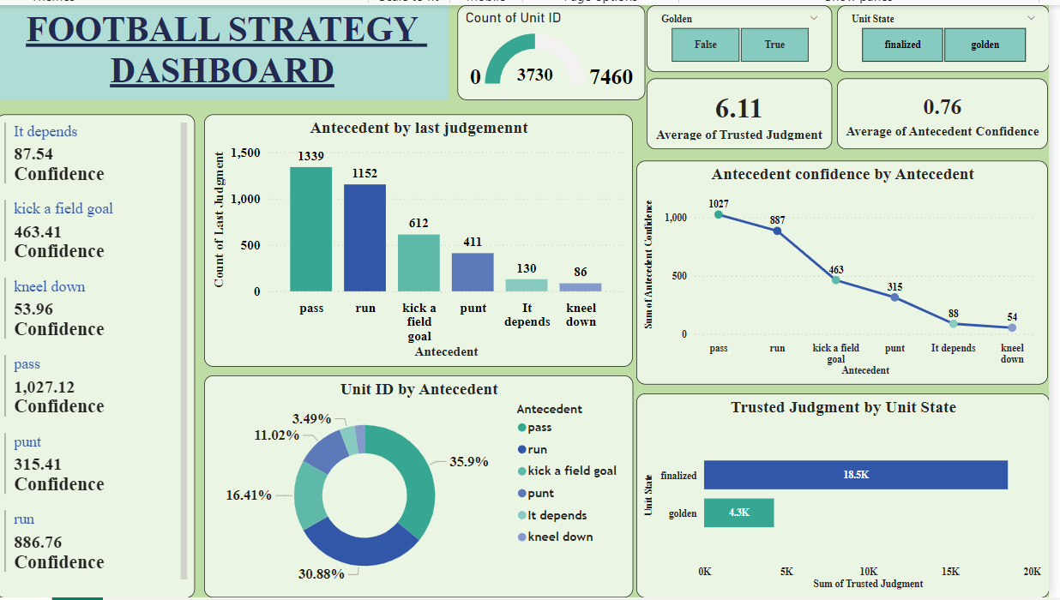

Slide 4
KEY INSIGHTS
The Football Strategy Dashboard showcases "pass" as the top strategy with a confidence score of 1,027.12.
"Run" and "kick a field goal" are significant but have lower confidence ratings.
There is a strong relationship between antecedent confidence and last judgment, highlighting the importance of data-driven decisions.
The dashboard serves as a valuable resource for coaches and analysts to refine tactics.
Overall, it aims to enhance team performance through improved strategic planning.

Slide 5
CONCLUSION
The football strategy analysis highlights that passing and running are the most trusted and frequently used plays, forming the backbone of strategic decisions. By focusing on key strategies, the project highlights the importance of established plays while emphasizing the need for adaptability in situational scenarios. The dashboard serves as a valuable tool for coaches and analysts, enabling them to refine their offensive strategies and make informed, data-driven decisions to improve team performance on the field. Overall, the project contributes significantly to strategic planning in football.

Slide 6
THANK
YOU

